Slide 1
Welcome to Technical Bootcamp: Day 1

Slide 2

A look into the Day 1 agenda:
Day 1
8:00
Keynote: Welcome, Objectives, Synapse 101
8:15
Demo Walkthrough – MDW in Action
8:45
Break
Please refer to the descriptions below for reference
9:00
Design Presentation: Data Loading & Data Lake Organization
Types of activities:
Attendees will participate in four different types of activities:
10:00
Q&A / Digital Cohort Activity: Data Lake Design & Security Considerations
11:00
Keynote
Labs
11:15
Break
Build Hands-on: Data Integration Part 1
Presentations
Challenges
Teams Cohort Activities
12:00
Lunch
Location of activities:
Each activity will take place in the following location:
13:00
Design Presentation: Data Transformations
13:30
Q&A / Digital Cohort Activity: Data Engineering Discussion
14:00
Build Hands-on: Data Integration Part 2
All-up Session: Teams bridge in calendar invite
Teams Cohort: “Meet Now” function in Teams Cohort Teams channel
15:00
Closing
Independent working time: No meeting, working in Spektra labs

Slide 3
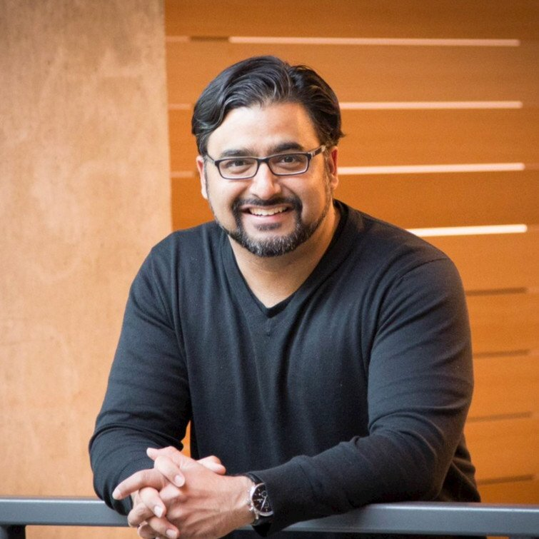
Keynote
Taimur Rashid
GM, Data & AI
Customer Success

Slide 4
Azure Synapse 101 & Demonstration
Matt Basile

Slide 5

Break
Please take this time for a short 15 minute break
Relax and come back refreshed for our next activity
If at anytime you require assistance please send a message to the “Need help – ask here” channel in the Microsoft Teams site for this event

Slide 6
Placeholder for Design Presentation: Data Loading & Data Lake Organization

Slide 7

Breakout Activity: Data Lake Design & Security Considerations
Objective: As a result of participating in this activity, you will better be able to design, optimize and secure a file system within ADLS Gen2.
What you will be doing: Within your breakout group in Teams, you will collaborate with your peers on a shared whiteboard. The whiteboard has some pre-populated questions that you and the team will be answering together. The activity will be facilitated by a Learning Adviser, who will be there to support and guide the group.
Total Activity Time: 60 minutes

Slide 8


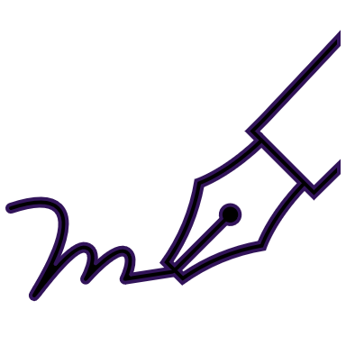


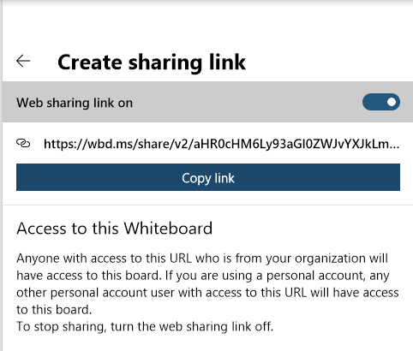
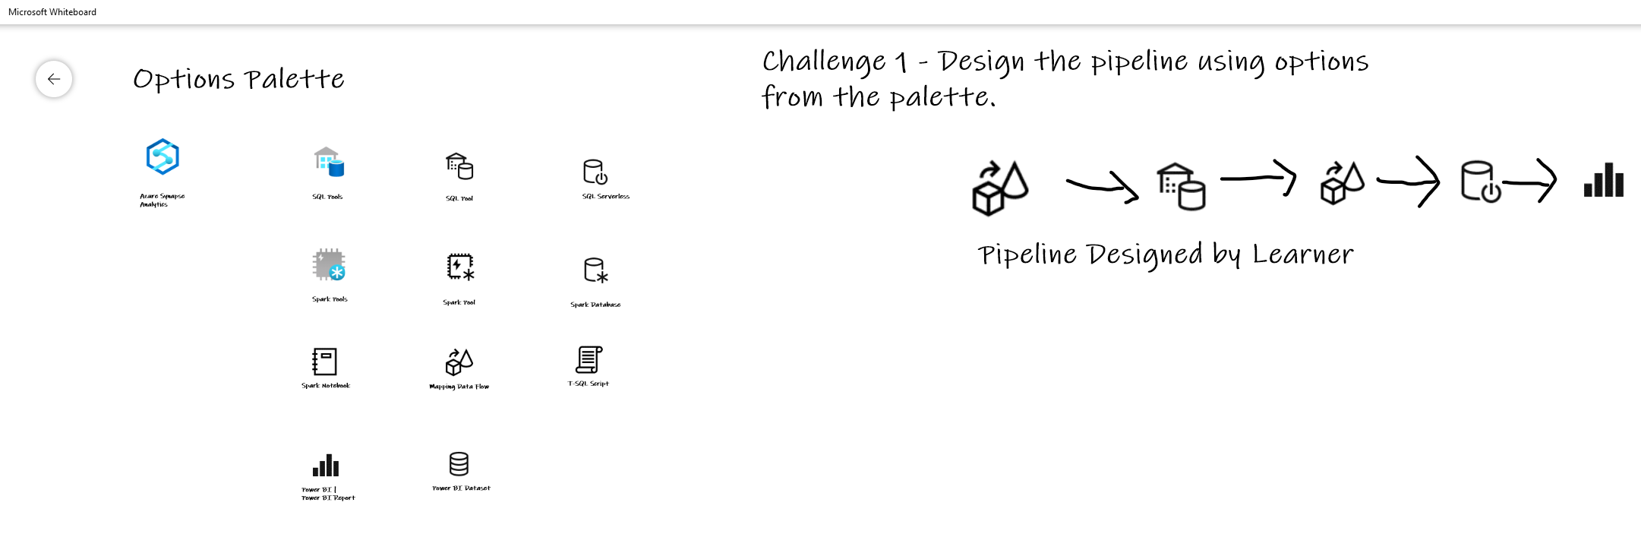

Activity: group-based whiteboard exercise
Step 1: Go to your table group channel
Step 2: Your Learning Adviser will provide a whiteboard link
Step 3: Load the whiteboard and begin activity collaboration with your table group via a Microsoft Teams “meet now” call (meet now button in upper right corner of application)

Slide 9
Break
Please take this time for a short 15 minute break
Relax and come back refreshed for our next activity
If at anytime you require assistance please send a message to the “Need help – ask here” channel in the Microsoft Teams site for this event

Slide 10

Hands-On Build Activity: Data Integration Part 1
Objective: As a result of participating in this lab, you will be better able to architect and deploy data integration pipelines
What you will be doing: This will be a chance for you to work individually in your lab environment to complete a set of tasks you would typically follow in work associated with ingesting and integrating your customer’s data. A set of tasks are outlined for you to follow and complete.
Total Activity Time: 45 minutes

Slide 11



Lab: individual lab exercise
Step 1: Go to your table group channel
Step 2: Your Learning Adviser will provide you a unique cloud lab login link
Step 3: Login and begin the lab. Engage your table group via a Microsoft Teams “meet now” call to support each other (meet now button in upper right corner of application)

Slide 12

Break
Please take this time for a 1-hour break
But first, a thought exchange question
Now, take time to relax and come back refreshed for our next activity
If at anytime you require assistance please send a message to the “Need help – ask here” channel in the Microsoft Teams site for this event

Slide 13
Placeholder for Design Presentation: Data Transformations

Slide 14
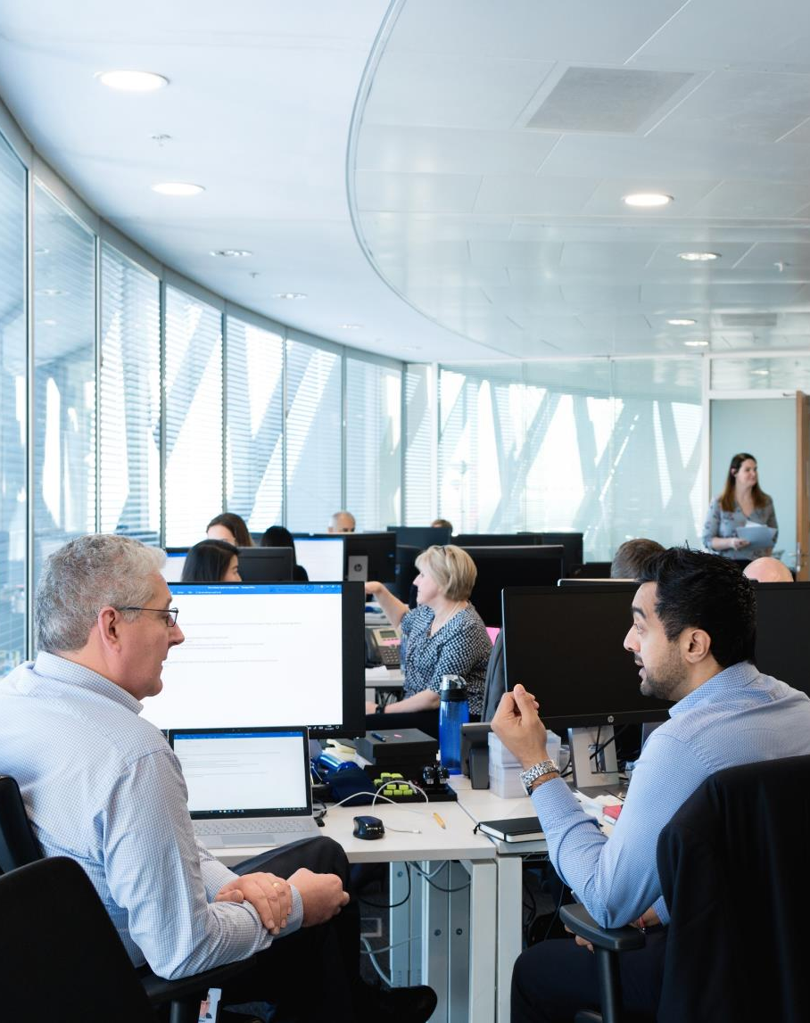
Full Group Activity: Data Engineering Discussion
Objective: As a result of participating in this activity, you will better be able to decide on which Azure Synapse Analytics component to use for specific data engineering scenarios.
What you will be doing: The facilitator will be posting questions to the entire group using an interactive tool called Mentimeter. The answers you post using Mentimeter will then drive the Data Engineering Discussion.
Total Activity Time: 30 minutes

Slide 15
Placeholder for Data Engineering Discussion Mentimeter

Slide 16
Hands-On Build Activity: Data Integration Part 2
Objective: As a result of participating in this lab, you will be better able to build data pipelines that integrate disparate data sources and handle poorly formatted data during ingestion.
What you will be doing: Like the Part 1 exercise, you work individually in your lab environment to complete a set of tasks you would typically follow in work associated with ingesting and integrating your customer’s data. A set of tasks are outlined for you to follow and complete.
Total Activity Time: 60 minutes

Slide 17
Lab: individual lab exercise
Step 1: Go to your table group channel
Step 2: Your Learning Adviser will provide you a unique cloud lab login link
Step 3: Login and begin the lab. Engage your table group via a Microsoft Teams “meet now” call to support each other (meet now button in upper right corner of application)

Slide 18

Day 1 Wrap Up
Thank you for your participation in the Day 1 Technical Boot Camp
What was covered today:
Design, optimize, and secure a file system within ALDS Gen2
Decide on which Azure Synapse Analytics component to use for specific data engineering scenarios
What we will learn tomorrow:
Implement optimization strategizes for data warehouse using SQL
Apply security concepts to a customer scenario
If at anytime you require assistance please send a message to the “Need help – ask here” channel in the Microsoft Teams site for this event

Slide 20
Welcome to Technical Bootcamp: Day 2

Slide 21
A look into the Day 2 agenda:
Day 2
8:00
Design Presentations: DW Optimization
8:15
8:45
Break
Please refer to the descriptions below for reference
9:00
Build Hands-on: DW Optimization Part 1
Types of activities:
Attendees will participate in four different types of activities:
10:00
Q&A / Digital Cohort Activity: DW Optimization
Design Presentation: DW Optimization Part 2
11:00
Keynote
Labs
11:15
Break
Build Hands-on: DW Optimization Part 2
Presentations
Challenges
Teams Cohort Activities
12:00
Lunch
Location of activities:
Each activity will take place in the following location:
13:00
Q&A / Digital Cohort Activity: Security
13:30
14:00
Build Hands-on: Security
All-up Session: Teams bridge in calendar invite
Teams Cohort: “Meet Now” function in Teams Cohort Teams channel
15:00
Closing
Independent working time: No meeting, working in Spektra labs

Slide 22
Placeholder for Design Presentation: Data Warehouse Optimization

Slide 23
Break
Please take this time for a short 15 minute break
Relax and come back refreshed for our next activity
If at anytime you require assistance please send a message to the “Need help – ask here” channel in the Microsoft Teams site for this event

Slide 24
Hands-On Build Activity: Data Warehouse Optimization Part 1
Objective: As a result of participating in this lab, you will be better able to optimize Data Warehouse query performance within deployed Azure Synapse Analytics solutions
What you will be doing: This will be a chance for you to work individually in your lab environment to complete a set of tasks you would typically follow in work associated with optimizing your customer’s data after you have completed your data ingestion. A set of tasks are outlined for you to follow and complete.
Total Activity Time: 60 minutes

Slide 25
Lab: individual lab exercise
Step 1: Go to your table group channel
Step 2: Your Learning Adviser will provide you a unique cloud lab login link
Step 3: Login and begin the lab. Engage your table group via a Microsoft Teams “meet now” call to support each other (meet now button in upper right corner of application)

Slide 26


Objective: As a result of attending this, attendees will better be able to implement optimization strategizes for the data warehouse using SQL based approached in Azure Synapse Analytics.
Breakout Activity: Data Warehouse Optimization
What you will be doing: Within your breakout group in Teams, you will collaborate with your peers to review challenges and decide on how to address them. Working within a shared labs environment (one lab environment per cohort), you will complete the challenges using Azure Synapse Analytics Studio. The challenges cover table and index configuration and query performance optimization.
Total Activity Time: 30 minutes

Slide 27
Activity: group-based lab exercise
Step 1: Go to your table group channel
Step 2: Your Learning Adviser will provide you a unique cloud lab login link
Step 3: Login and begin the lab. Engage your table group via a Microsoft Teams “meet now” call to collaborate with each other (meet now button in upper right corner of application)

Slide 28
Placeholder for Design Presentation: Data Warehouse Optimization Part 2

Slide 29
Break
Please take this time for a short 15 minute break
Relax and come back refreshed for our next activity
If at anytime you require assistance please send a message to the “Need help – ask here” channel in the Microsoft Teams site for this event

Slide 30
Hands-On Build Activity: Data Warehouse Optimization Part 2
Objective: As a result of participating in this lab, you will be able to optimize the data warehouse table configuration and understand the impact on query performance
What you will be doing: Like the Part 1 exercise, you work individually in your lab environment to complete a set of tasks you would typically follow in work associated with optimizing your customer’s data after you have completed your data ingestion. A set of tasks are outlined for you to follow and complete.
Total Activity Time: 45 minutes

Slide 31
Lab: individual lab exercise
Step 1: Go to your table group channel
Step 2: Your Learning Adviser will provide you a unique cloud lab login link
Step 3: Login and begin the lab. Engage your table group via a Microsoft Teams “meet now” call to support each other (meet now button in upper right corner of application)

Slide 32
Break
Please take this time for a 1-hour break
But first, a thought exchange question
Now, take time to relax and come back refreshed for our next activity
If at anytime you require assistance please send a message to the “Need help – ask here” channel in the Microsoft Teams site for this event

Slide 33
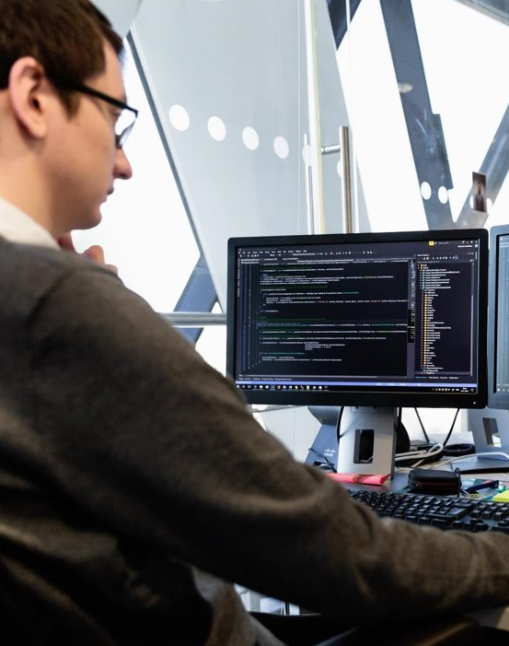
Breakout Activity: Security
Objective: As a result of attending this, you will better be able to apply security concepts including row level security, object level security, column level security, sensitive data discovery and classification and access controls to a customer scenario.
What you will be doing: Within your breakout group in Teams, you will collaborate with your peers on a shared whiteboard. As a team, you will review WWI requirements provided in student guide. Students will open the whiteboard and as a team answer the provided challenge questions. The questions will be pre-loaded into the whiteboard.
Total Activity Time: 60 minutes

Slide 34
Activity: group-based whiteboard exercise
Step 1: Go to your table group channel
Step 2: Your Learning Adviser will provide a whiteboard link
Step 3: Load the whiteboard and begin activity collaboration with your table group via a Microsoft Teams “meet now” call (meet now button in upper right corner of application)

Slide 35
Hands-On Build Activity: Security
Objective: As a result of participating in this activity, you will practice and be able to articulate several security-related steps that cover an end-to-end security story for Azure Synapse Analytics.
What you will be doing: This will be a chance for you to work individually in your lab environment to complete a set of tasks you would typically follow in work associated with ingesting and integrating your customer’s data. A set of tasks are outlined for you to follow and complete.
Total Activity Time: 60 minutes

Slide 36
Lab: individual lab exercise
Step 1: Go to your table group channel
Step 2: Your Learning Adviser will provide you a unique cloud lab login link
Step 3: Login and begin the lab. Engage your table group via a Microsoft Teams “meet now” call to support each other (meet now button in upper right corner of application)

Slide 37
Day 2 Wrap Up
Thank you for your participation in the Day 2 Technical Boot Camp
What was covered today:
Implement optimization strategizes for the data warehouse using SQL based approached in Azure Synapse Analytics.​
Apply security concepts including row level security, object level security, column level security, sensitive data discovery and classification and access controls to a customer scenario
What we will learn tomorrow:
Implement a process to train a machine learning model
Address scenarios to monitor and manage Azure solutions
If at anytime you require assistance please send a message to the “Need help – ask here” channel in the Microsoft Teams site for this event

Slide 39
Welcome to Technical Bootcamp: Day 3

Slide 40
A look into the Day 3 agenda:
Day 3
8:00
Design Presentation: Spark for Data Science
8:15
8:45
Break
Please refer to the descriptions below for reference
9:00
Build Hands-on: Machine Learning
Types of activities:
Attendees will participate in four different types of activities:
10:00
Q&A / Digital Cohort Activity: Model Implementation (Predict)
11:00
Keynote
Labs
11:15
Break
Build Hands-on: Spark ML
Presentations
Challenges
Teams Cohort Activities
12:00
Lunch
Location of activities:
Each activity will take place in the following location:
13:00
Design Presentation: Monitor & Manage
13:30
Q&A / Digital Cohort Activity: Monitor & Manage
14:00
Build Hands-on: Monitoring
All-up Session: Teams bridge in calendar invite
Teams Cohort: “Meet Now” function in Teams Cohort Teams channel
15:00
Closing
Independent working time: No meeting, working in Spektra labs

Slide 41
Placeholder for Design Presentation: Spark for Data Science

Slide 42
Break
Please take this time for a short 15 minute break
Relax and come back refreshed for our next activity
If at anytime you require assistance please send a message to the “Need help – ask here” channel in the Microsoft Teams site for this event

Slide 43
Hands-On Build Activity: Machine Learning
Objective: As a result of participating in this activity, you will be able to create several machine learning models and use them to make predictions using the T-SQL Predict statement.
What you will be doing: This will be a chance for you to work individually in your lab environment to complete a set of tasks you would typically follow in work associated with the model, manage & secure part of your process. A set of tasks are outlined for you to follow and complete.
Total Activity Time: 60 minutes

Slide 44
Lab: individual lab exercise
Step 1: Go to your table group channel
Step 2: Your Learning Adviser will provide you a unique cloud lab login link
Step 3: Login and begin the lab. Engage your table group via a Microsoft Teams “meet now” call to support each other (meet now button in upper right corner of application)

Slide 45

Breakout Activity: Model Implementation
Objective: As a result of attending this, you will better be able to implement a process that trains a machine learning model, registers it for use and utilize the model for scoring using the Predict statement.
What you will be doing: Within your breakout group in Teams, you will collaborate with your peers to review challenges and decide on how to address them. Working within a shared labs environment (one lab environment per cohort), you will complete the challenges using Azure Synapse Analytics Studio. The challenges cover model training, model registration, and scoring. During progression team results are collected and posted to an event leaderboard.
Total Activity Time: 60 minutes

Slide 46
Activity: group-based lab exercise
Step 1: Go to your table group channel
Step 2: Your Learning Adviser will provide you a unique cloud lab login link
Step 3: Login and begin the lab. Engage your table group via a Microsoft Teams “meet now” call to collaborate with each other (meet now button in upper right corner of application)

Slide 47
Break
Please take this time for a short 15 minute break
Relax and come back refreshed for our next activity
If at anytime you require assistance please send a message to the “Need help – ask here” channel in the Microsoft Teams site for this event

Slide 48
Hands-On Build Activity: Spark ML
Objective: As a result of participating in this activity, you will be able to train and deploy a recommender ML model
What you will be doing: This will be a chance for you to work individually in your lab environment to complete a set of tasks you would typically follow in work associated with ingesting and integrating your customer’s data. A set of tasks are outlined for you to follow and complete.
Total Activity Time: 60 minutes

Slide 49
Activity: group-based lab exercise
Step 1: Go to your table group channel
Step 2: Your Learning Adviser will provide you a unique cloud lab login link
Step 3: Login and begin the lab. Engage your table group via a Microsoft Teams “meet now” call to collaborate with each other (meet now button in upper right corner of application)

Slide 50
Break
Please take this time for a 1 hour break
But first, a thought exchange question
Now, take time to relax and come back refreshed for our next activity
If at anytime you require assistance please send a message to the “Need help – ask here” channel in the Microsoft Teams site for this event

Slide 51
Placeholder for Design Presentation: Monitor & Manage

Slide 52

Full Group Activity: Monitor & Manage
Objective: As a result of attending this, you will better be able to address scenarios that involve the design of how to monitor and manage a solution implemented with Azure Synapse Analytics.
What you will be doing: The facilitator will be posting questions to the entire group using an interactive tool called Mentimeter. The answers you post using Mentimeter will then drive the Data Engineering Discussion on Azure Synapse Analytics.
Total Activity Time: 40 minutes

Slide 53
Placeholder for Monitor & Manage Mentimeter

Slide 54
Hands-On Build Activity: Monitoring
Objective: As a result of participating in this lab, you will be able to build and deploy monitoring solutions for Azure Synapse Analytics and associated Spark applications.
What you will be doing: This will be a chance for you to work individually in your lab environment to complete a set of tasks you would typically follow in work associated with ingesting and integrating your customer’s data. A set of tasks are outlined for you to follow and complete.
Total Activity Time: 60 minutes
Notes:
For individual labs, add “work through your teams channel” vs just “individually” ☺

Slide 55
Lab: individual lab exercise
Step 1: Go to your table group channel
Step 2: Your Learning Adviser will provide you a unique cloud lab login link
Step 3: Login and begin the lab. Engage your table group via a Microsoft Teams “meet now” call to support each other (meet now button in upper right corner of application)

Slide 56
Day 3 Wrap Up
Thank you for your participation in the Day 3 Technical Boot Camp
PENDING sean/solliance info
What was covered today:
Implement a process that trains a machine learning model, registers it for use and utilizes the model for scoring using the Predict statement. ​
Address scenarios the involve the design of how to monitor and manage a solution implemented with Azure Synapse Analytics.
What we will learn tomorrow:
HOLD
HOLD
If at anytime you require assistance please send a message to the “General” chat in Microsoft Teams

Slide 58
Welcome to Technical Bootcamp: Day 4

Slide 59
A look into the Day 4 agenda
Day 4
8:00
Challenge Introduction
8:15
Begin POC Challenge
8:45
Please refer to the descriptions below for reference
9:00
Types of activities:
Attendees will participate in four different types of activities:
Break
10:00
Continue POC Challenge
11:00
Keynote
Labs
Break
11:15
Continue POC Challenge
Presentations
Challenges
Teams Cohort Activities
12:00
Lunch
Location of activities:
Each activity will take place in the following location:
13:00
Finish POC Challenge
13:30
14:00
Challenge Debrief
All-up Session: Teams bridge in calendar invite
Closing
Teams Cohort: “Meet Now” function in Teams Cohort Teams channel
15:00
Independent working time: No meeting, working in Spektra labs

Slide 60
Placeholder for Challenge

Slide 61
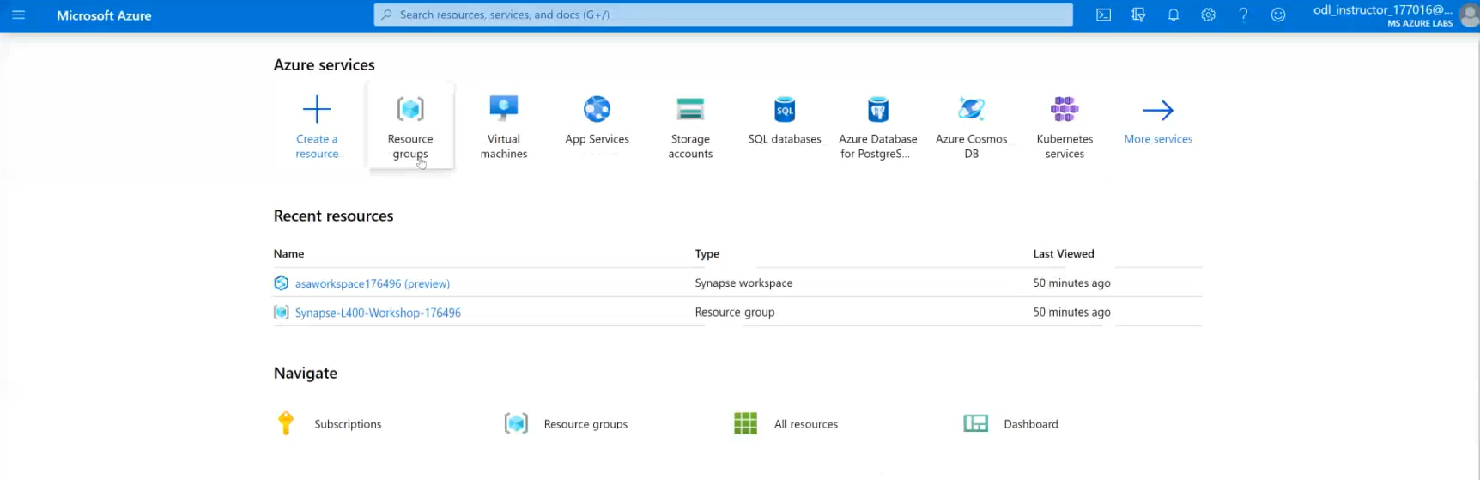
POC Challenge: group-based lab exercise
Step 1: Go to your table group channel
Step 2: You will use your cloud lab login for Azure
Step 3: Login to Azure. Engage your table group via a Microsoft Teams “meet now” call to collaborate with each other (meet now button in upper right corner of application)

Slide 62
Placeholder for Challenge Debrief

Slide 63
What we covered and how to continue to learn
Thank you for participating
What was covered this week:
Together we learned how to develop performant Azure Synapse Analytics proof-of-concepts using the latest functionality for data ingestion, transformation, query optimization, security, monitoring, and machine learning.
How to keep learning:
Watch and learn with Microsoft Build
Explore Microsoft.com/learn for on-demand learning
Connect with us in our upcoming Architecture Design series (details coming in June)
Pending updates on “how to continue” in run book - update based on info in run book

